Slide 1
2021 OSACA ORMAP ESRI Tools Committee Update
Dean Anderson-Polk County
ArcPro Design Subcommittee Clackamas County
Deschutes County
DOR
ESRI Olympia
ESRI Parcel Fabric Team
Polk County
Multnomah County Washington County
Rest of the Tools Committee
Clatsop County
Columbia County Harney County
Marion County
Thanks ESRI !

Slide 2


Our Tasks…..
Develop a New Design for ArcPro and ArcPro/Fabric
Create Sample Scripts to Show How Conversion Can Happen
Redevelop ArcPro ORMAP Tools
MapNumber and MapScale Assignment Addin
Find MapNumber/Taxlot Addin
Hooks & Arrows Addin
Map Production
Evaluate ArcPro/Fabric – Will it work for us ?
Identify Training – GIS / Admin / Cartographers
New Tasks
Enterprise Environment Sample
Create Sample Tasks
Expand Attribute Rules

Slide 3
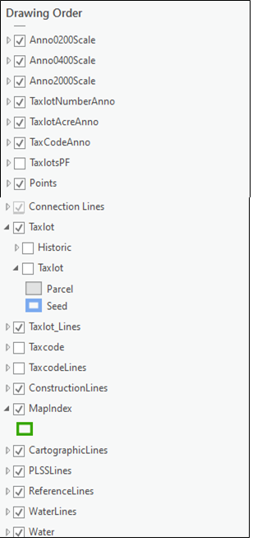
ORMAP ArcPro/Fabric Design Highlights
Kept the same feature class names and structure where possible
Annotation in ArcPro is different from ArcMap so this is a one way trip
The new CoGo attributes are numeric
Changed length on text attributes to a default of 255
New fields have been added to the MapIndex feature class (title)
Taxlot, TaxlotLines, and Points (old corners) are part of a Fabric Feature Dataset
Design accommodates the ParcelFabric but does not force users to it
Taxlot, Taxlot Lines, Points are just standard feature classes
Parcel Fabric is managed with topology and relationship classes
Works with both Enterprise or File Geodatabase Enironments
FABRIC

Slide 4
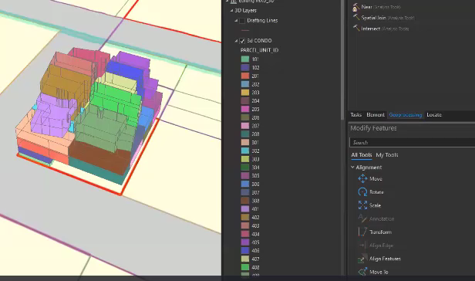
ORMAP ArcPro/Fabric –A New Condo Design
VIDEO

Slide 5
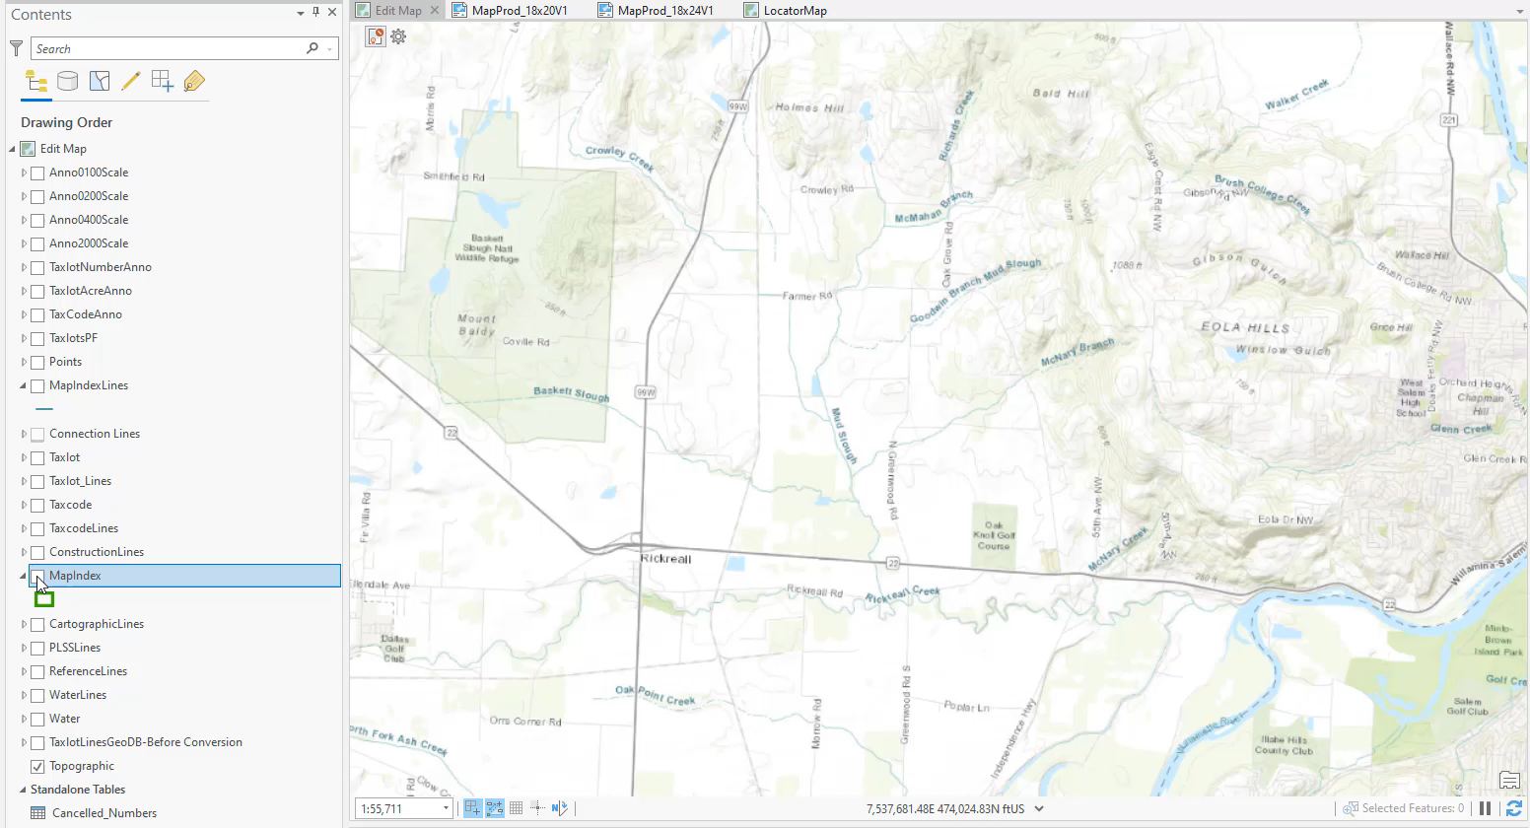
ORMAP ArcPro/Fabric– Conversion
VIDEO
Sample Geodatabase and Python Scripts are Available

Slide 6
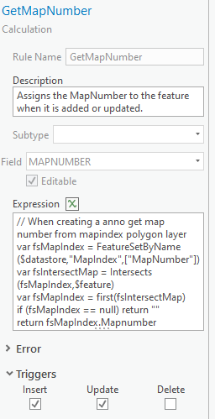
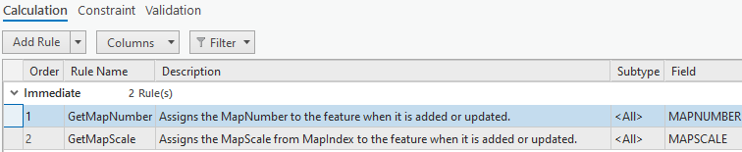
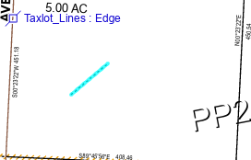
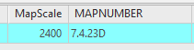
ORMAP Tools – 1. Assign MapNumber / MapScale
Replaced using “Attribute Rules”
Attribute rules are built into the ORMAP design
Arcade
ESRI has a set of rules that can be used (or not) with fabric
The tools committee also has a set of rules for ORMAP

Slide 7
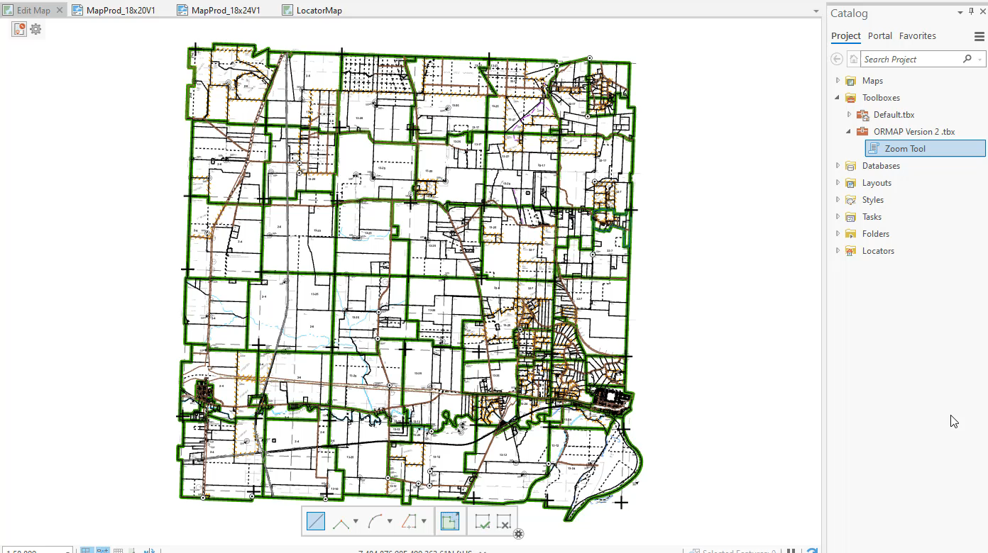
ORMAP Tools – 2. Find Map/Taxlot
VIDEO

Slide 8
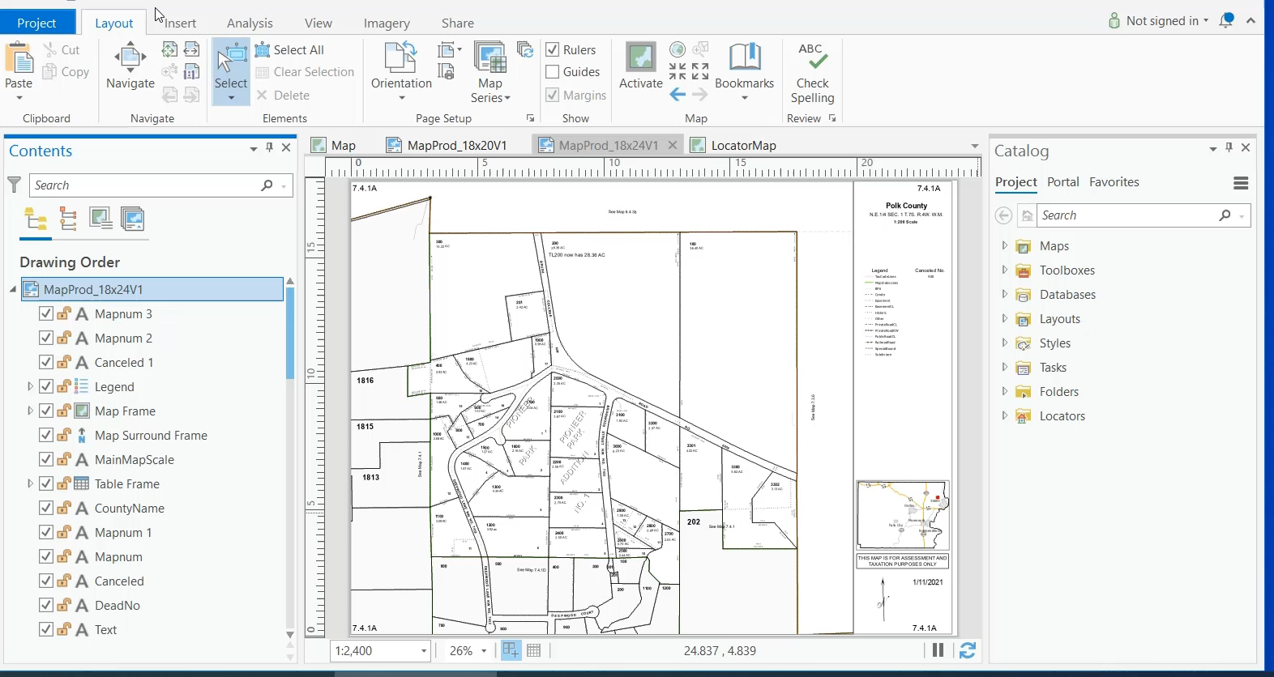
ORMAP Tools – 3. Map Production
VIDEO
Do we really need the 18x20 format?

Slide 9
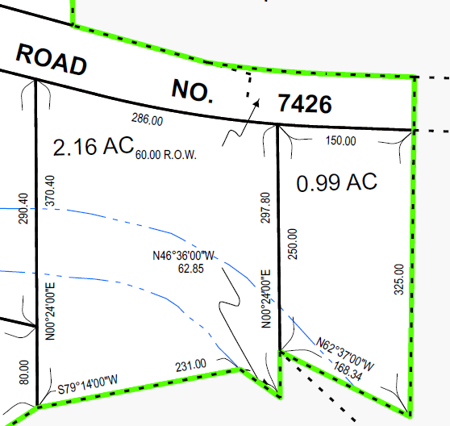
ORMAP Tools – 4. Hooks and Arrows
Add and Adjust Arrows, Hooks, and Land Hooks based on map scale.
John Prychon’s Tool
(Not Done)
Are you using this tool or would you like to use it?

Slide 10
ArcPro/Fabric Review – Top10(+2) Things I like
We are FINALLY managing “RECORDS”
Fabric Feature Class are standard
CoGo Works on Standard Features Classes
We Can Now Create “Tasks” (Segs, Subdivisions, Annexations)
New Attribute Rules
Traverse is Improved
Better Road Centerline and Offset
Improved Bearing/Bearing – Distance/Distance
Better Versioning in Enterprise (Branched)
New Alignment and Least Squares Adjustment Tools
Measure does various inverses
Rotate is Improved
Traverse Closure Options (coming soon)
Area Report(coming soon)

Slide 11
Training Options
Admin Staff – 10 Admin Users took 2 ESRI Enterprise Classes
“Deploying and Maintaining a Multiuser Geodatabase”
“ArcGIS Enterprise: Configuring a Base Deployment”
GIS Staff – Several staff have taken ESRI’s Parcel Fabric Class
“Working with Parcel Data in ArcGIS Pro”
Cartographers – ESRI’s Parcel Fabric Class Is Available To Be Discussed
“Working with Parcel Data in ArcGIS Pro”
Lots of ESRI Resources
Do you want a future Parcel Editing Workshop?

Slide 12
Tools Committee – What’s Next ?
Finish Tool Assessment (Get Your Input)
Identify Other Needed Tools - Email Me (Tools You Need)
Tool Name
How Important
What it does
Your contact info
Build Arrow/Hook Tool
“Operational Tool Tests”
Create Sample Tasks: Put Tools Together to Accomplish Tasks
Develop Enterprise Sample Environment
You need to get started.

Slide 13
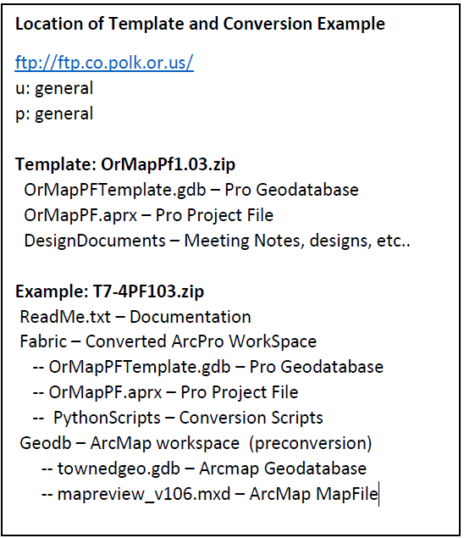
Tools Review – ORMAP Version 1.03
What else do you want from the Tools Committee?

